Slide 1
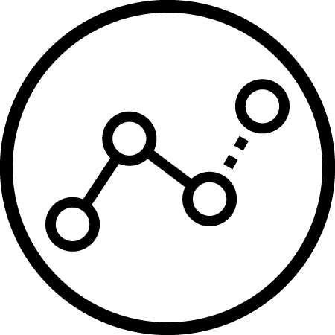






The AI Canvas
What task/decision are you examining?
Briefly describe the task being analyzed.
Prediction
Judgment
Action
Outcome
Identify the key uncertainty that you would like to resolve.
Determine the payoffs to being right versus being wrong. Consider both false positives and false negatives.
What are the actions that can be chosen?
Choose the measure of performance that you want to use to judge whether you are achieving your outcomes.
Training
Input
Feedback
What data do you need on past inputs, actions and outcomes in order to train your AI and generate better predictions?
What data do you need to generate predictions once you have an AI algorithm trained?
How can you use measured outcomes along with input data to generate improvements to your predictive algorithm?
How will this AI impact on the overall workflow?
Explain here how the AI for this task/decision will impact on related tasks in the overall workflow. Will it cause a staff replacement? Will it involve staff retraining or job redesign?
© Agrawal, Gans, Goldfarb 2019

